Slide 1
The Technical Skills of Photography: Gr 11 Media & Gr 12 Photography
WARNING for some this may be a bit of a review. But you are responsible for these terms, and I expect you to show evidence of these skills in your photographs this semester.
Ms. Cameron - PCI Visual Art

Slide 2
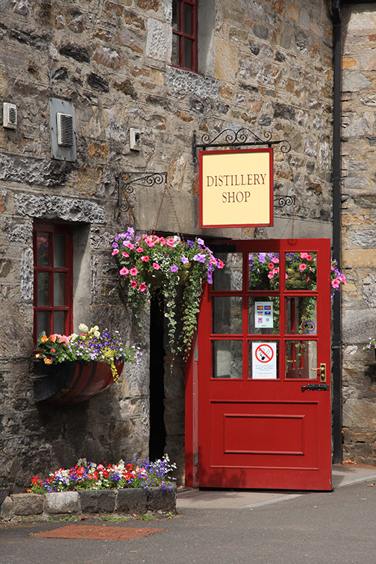
Composition
The way the elements or the subject is arranged.
Success = pulling the viewers eye across the whole image (so that everything is taken in) and then finally settling on the main subject

Slide 3
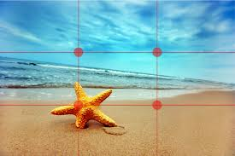
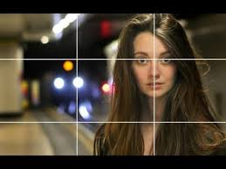
Rule of Thirds
Image is divided horizontally and vertically into equal sections of three
Main subject is positioned at the intersection of any two of the lines.

Slide 4
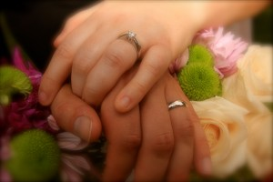
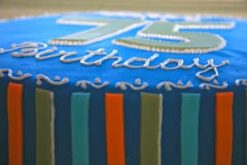
Tight Crop
Intentionally moving the camera close to the subject to create focus or abstract the image.

Slide 5
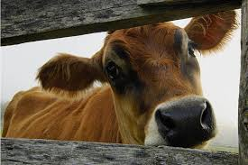
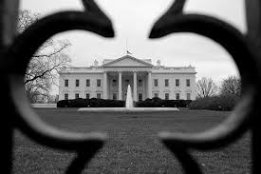
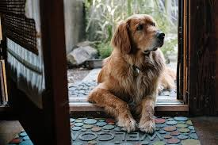
Framing
Using natural frames to draw your eye to a main area of focus

Slide 6
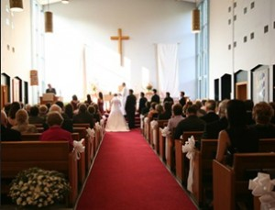
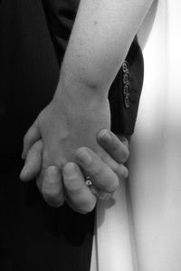
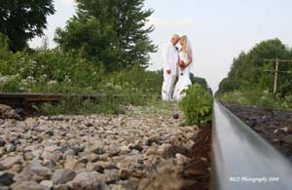
Proximity
How close or far you are away from your subject creates different moods and focus

Slide 7
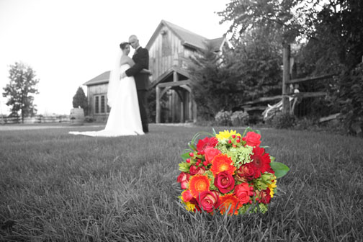
Point of View
The level of the camera in relation to the subject.
It can affect the mood of the photo.

Slide 8
Point of View
It can flatter or distort the subject.
Double chin…
Short…
Tall…
Tall and Short person together…

Slide 9
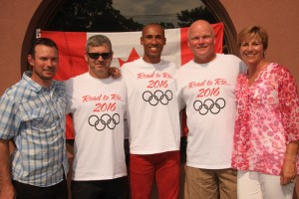
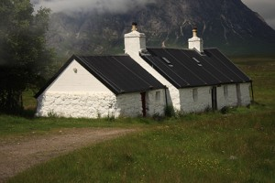
Camera Angles: Eye-Level
This is the most common view, being the real-world angle that we are all used to. It shows subjects as we would expect to see them in real life. It is a fairly neutral shot.

Slide 10
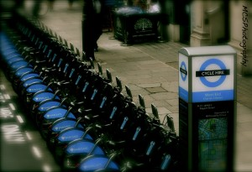
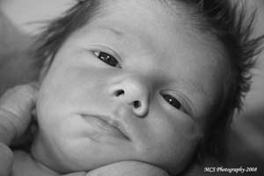
Camera Angles: High Angle
the camera is angled down towards the subject. This has the effect of diminishing the subject, making them appear less powerful, less significant or even submissive.

Slide 11
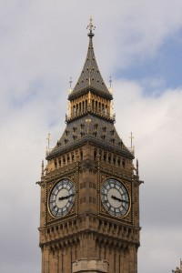
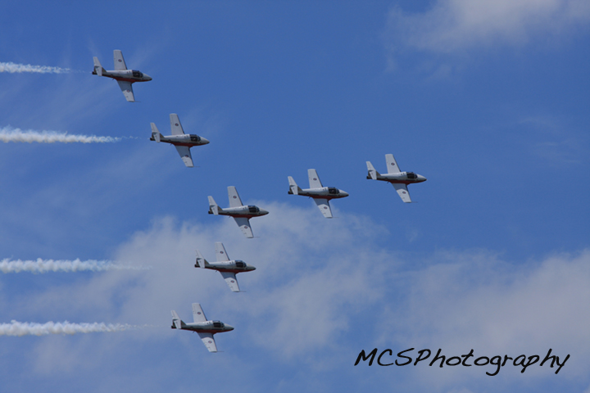
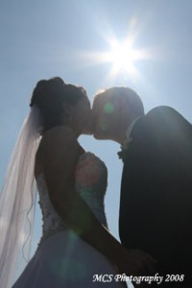
Camera Angles: Low Angle
This shows the subject from below, giving them the impression of being more powerful or dominant.

Slide 12
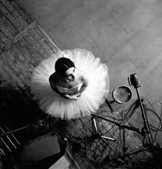
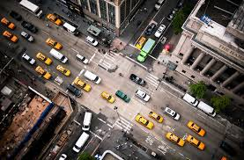
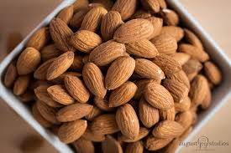
Camera Angles: Bird's Eye
The scene is shown from directly above. This is a completely different and somewhat unnatural point of view which can be used for dramatic effect or for showing a different spatial perspective.

Slide 13
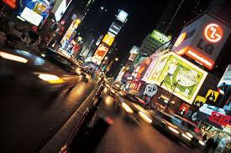
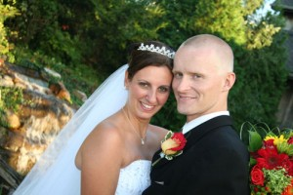
Camera Angles: Slanted/Dutch Tilt
the camera is purposely tilted to one side so the horizon is on an angle. This creates an interesting and dramatic effect.
Dutch tilts are also popular in MTV-style video production, where unusual angles and lots of camera movement play a big part.

